Slide 1

Sprint 3
Internship Group- 2

Slide 2
What is YOLO ?
You Only Look Once (YOLO) You Only Look Once (YOLO) is one of the most popular model architectures and object detection algorithms. It uses one of the best neural network architectures to produce high accuracy and overall processing speed, which is the main reason for its popularity

Slide 3
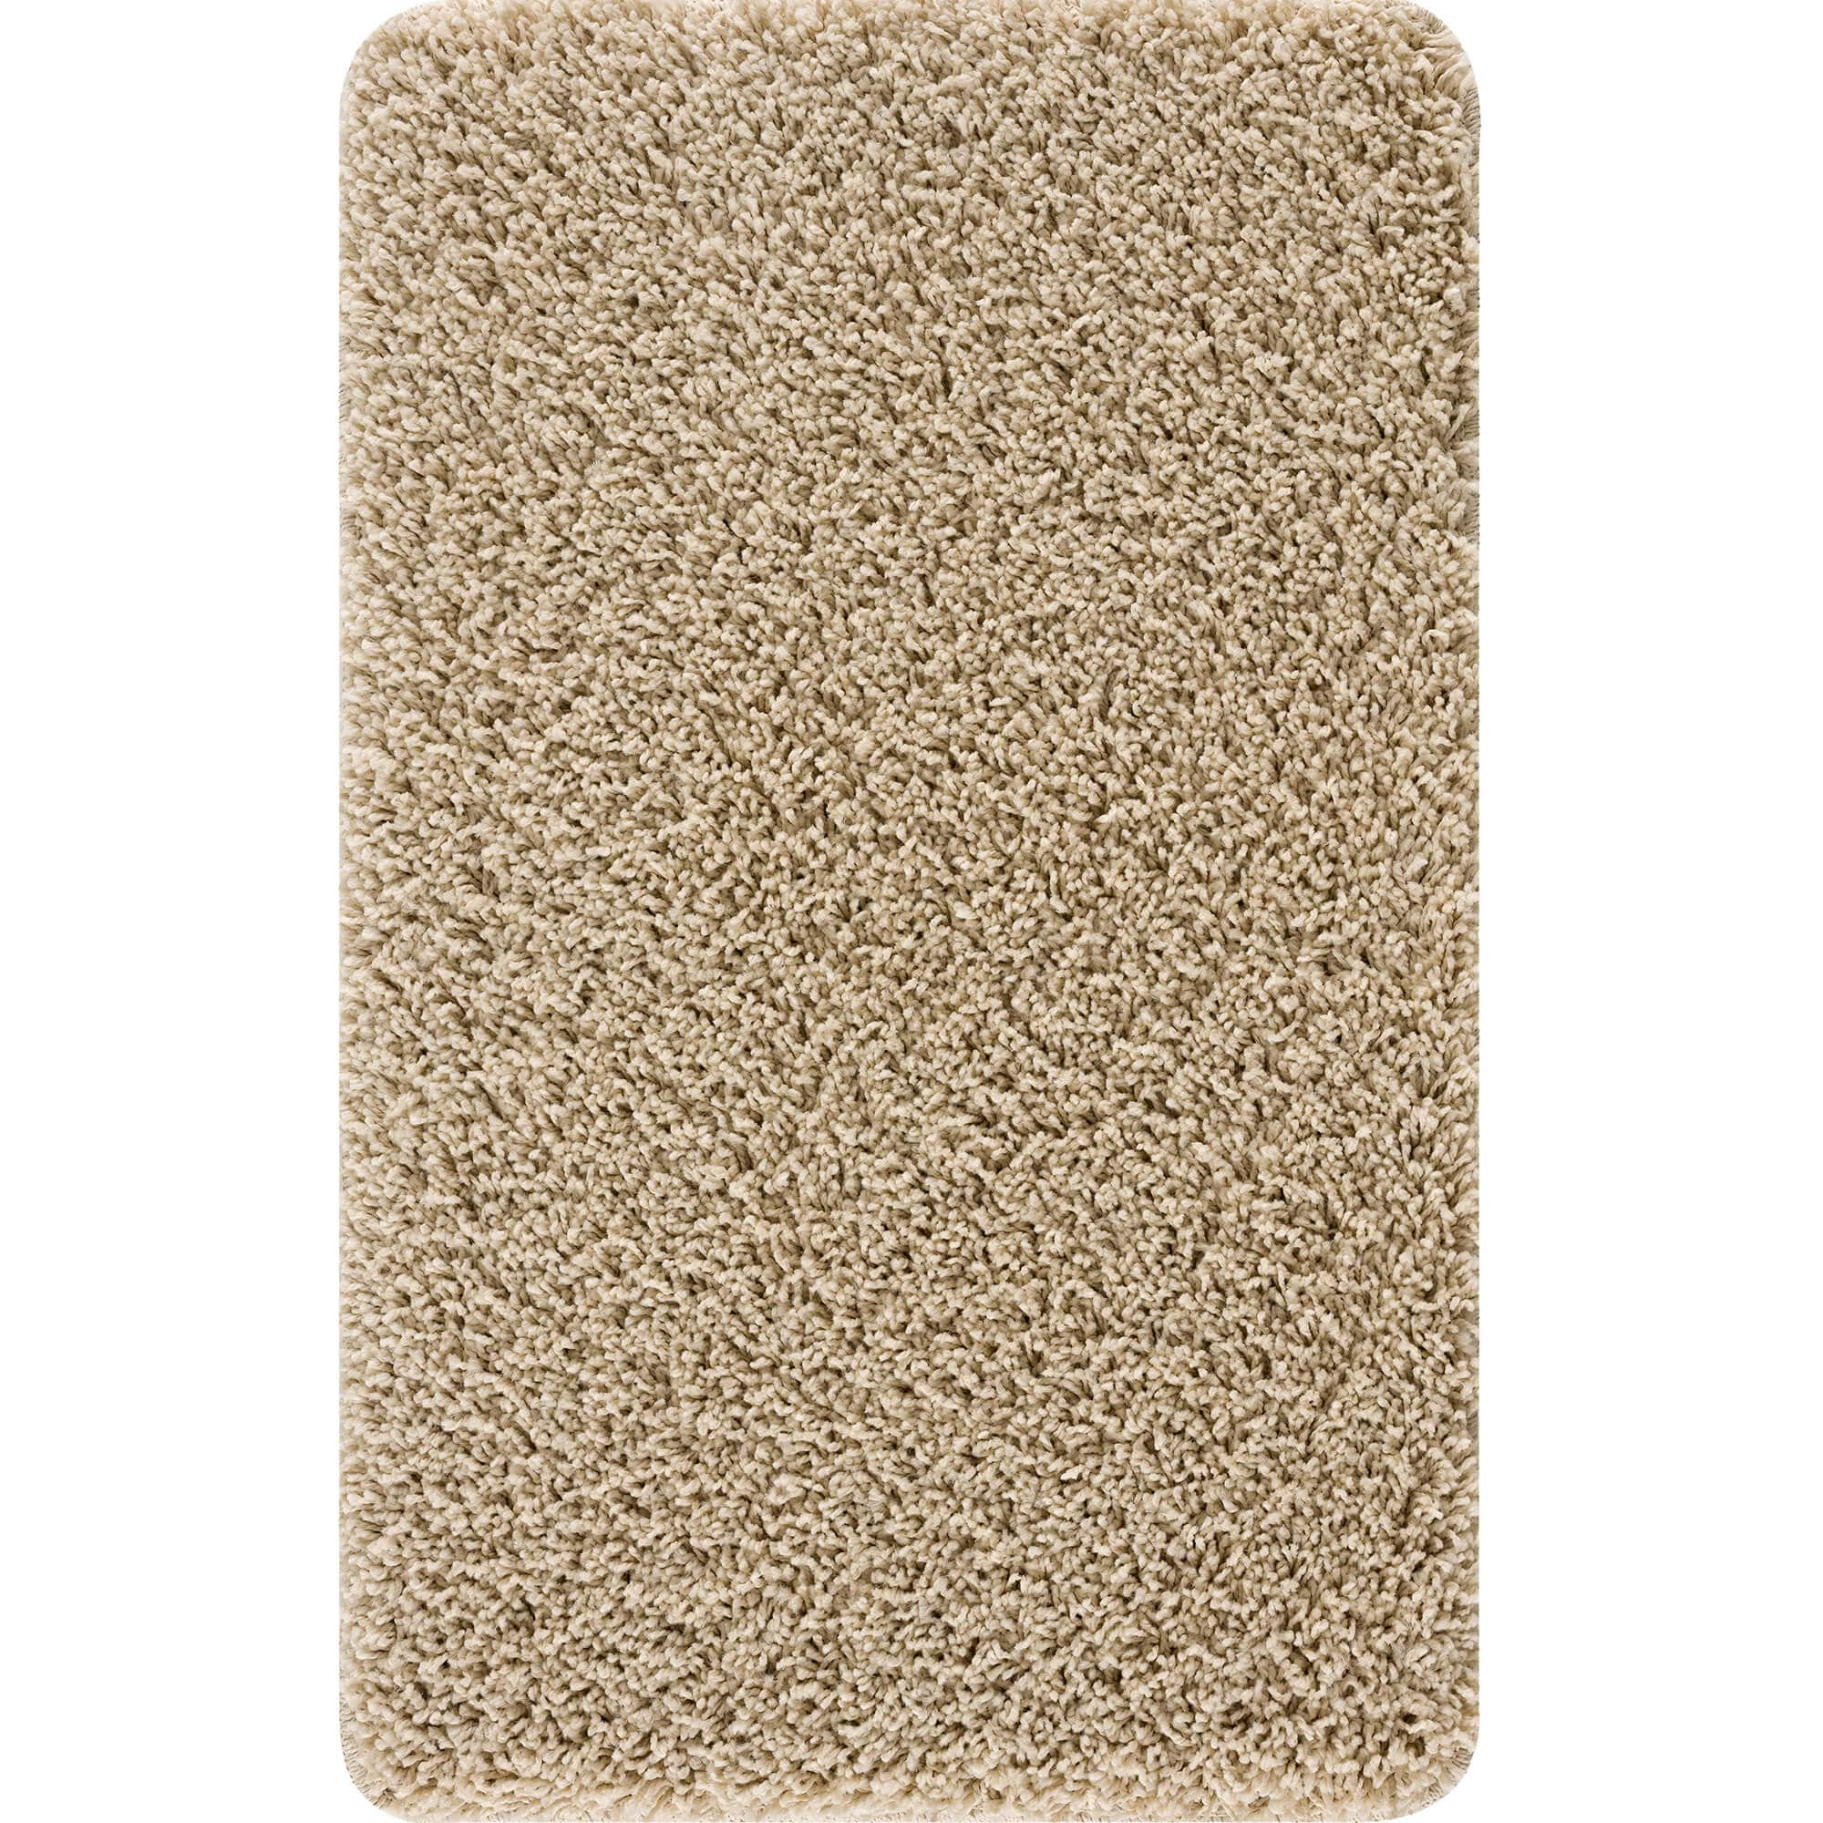
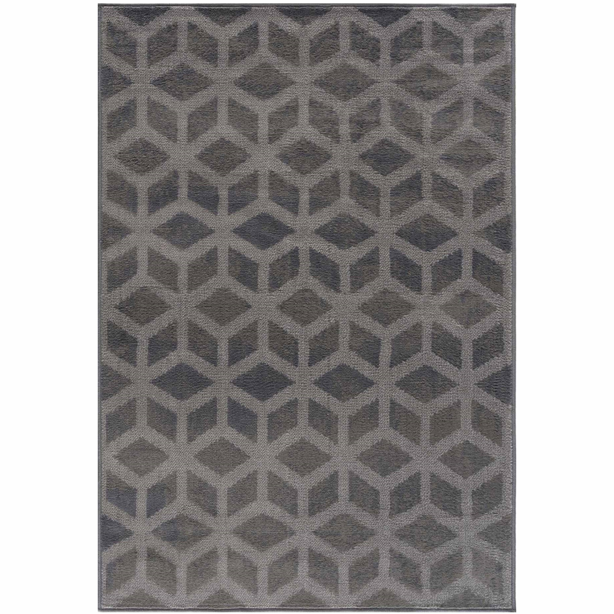
Our YOLO models
1. Color Based (14 Categories)
Beige
Black
Blue
Brown
Duck Egg
Green
Grey
Multicolor
Orange
Pink
Purple
Red
White
Yellow

Slide 4
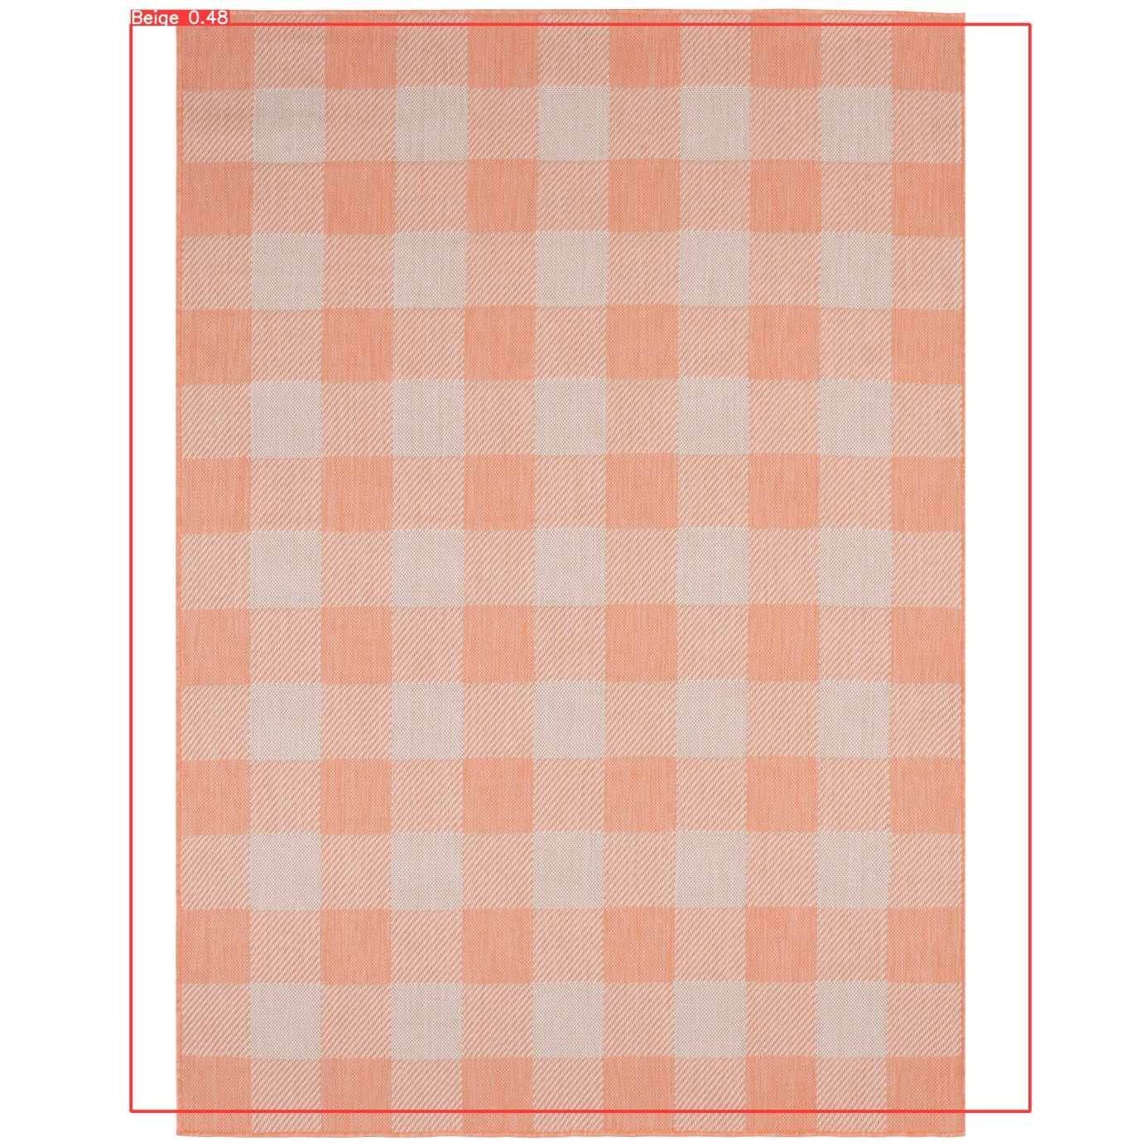
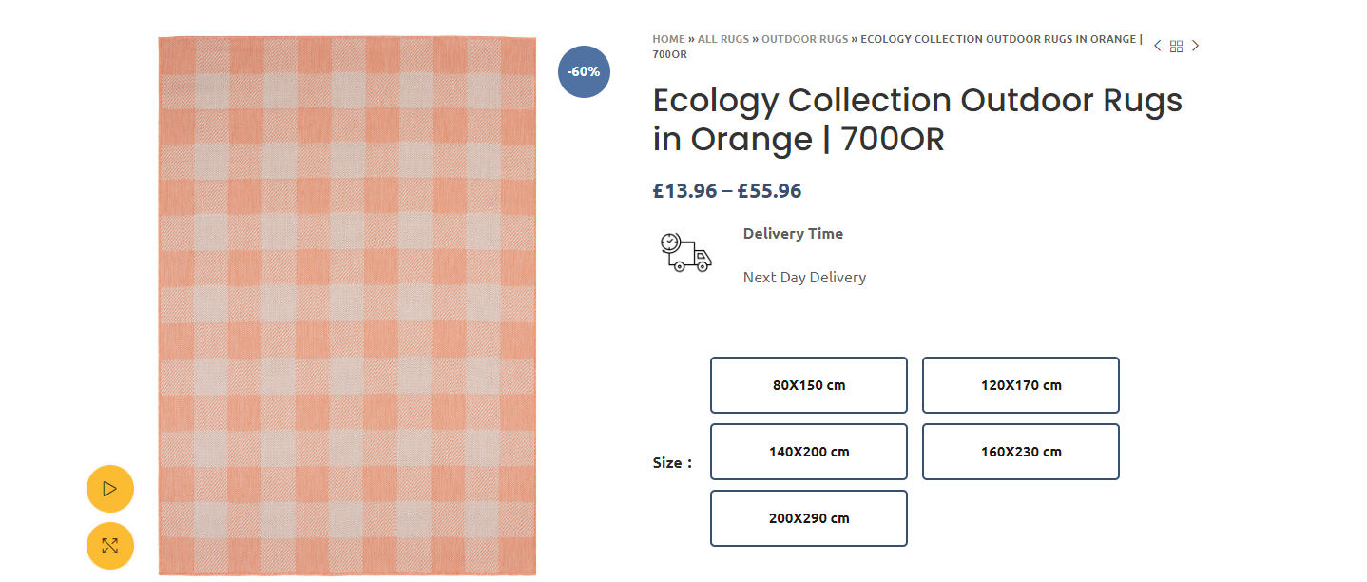
Color Model Result

Slide 5
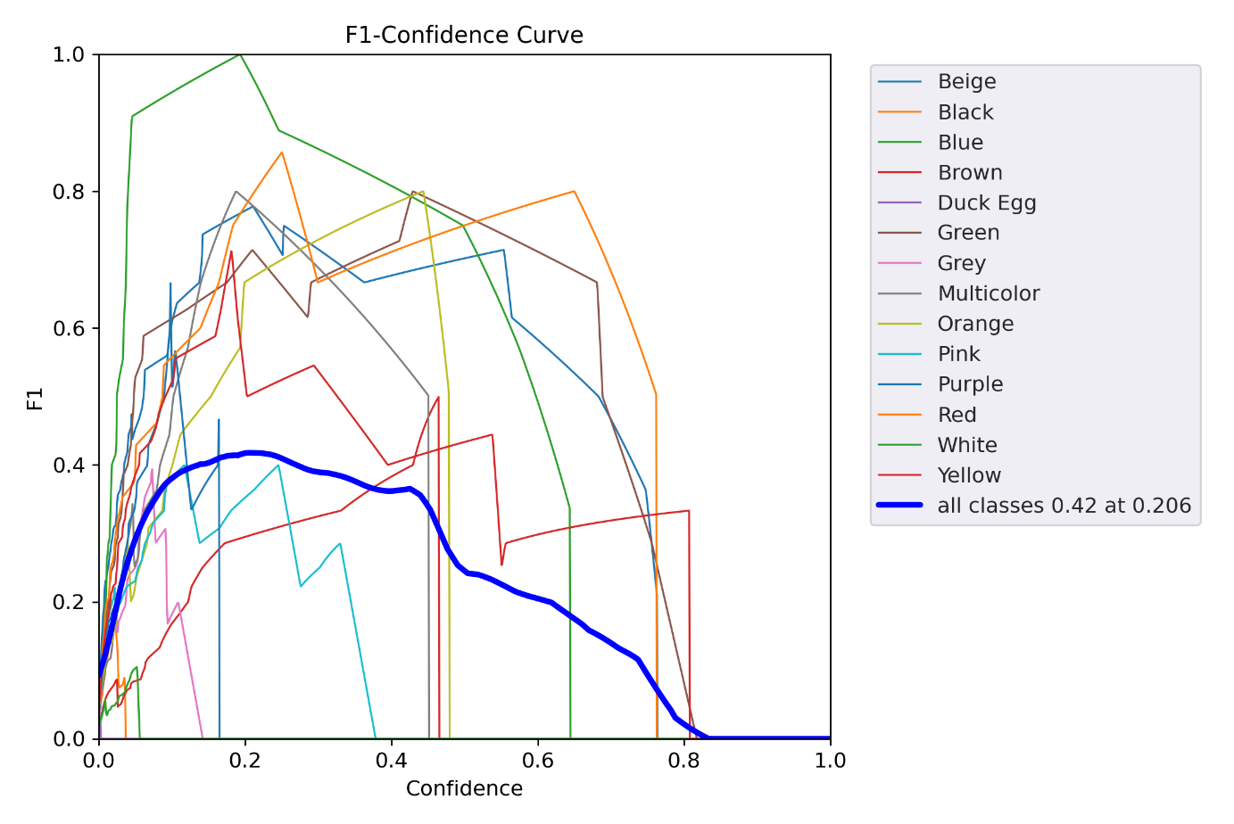
Color Model Result

Slide 6
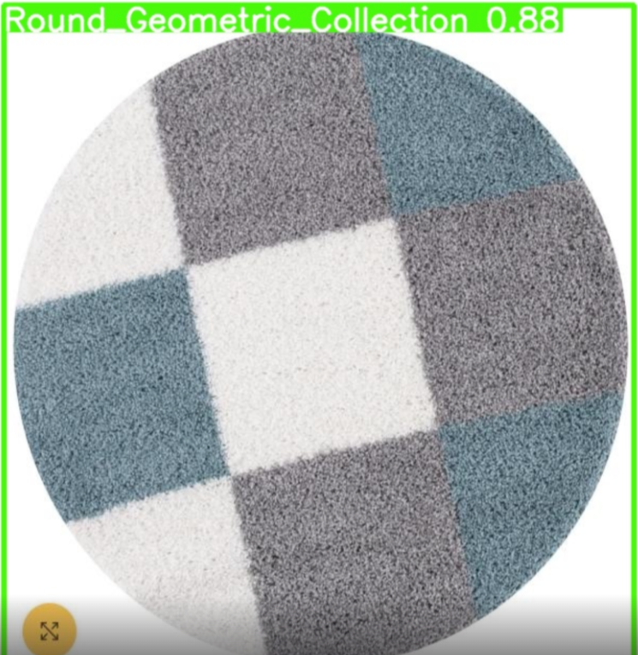
Collections Model
Derby Format
Doormats Coir Collection
Eco Barrier
Shaggy Moraccan Design
Shaggy Geometric Design
Shaggy Diamond Design
Round Geometric Collection
Round Shaggy Collection

Slide 7
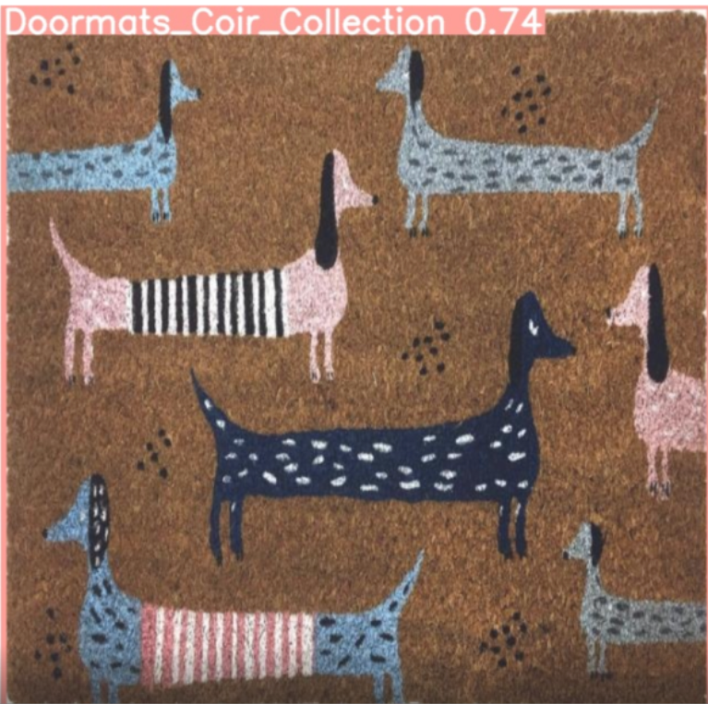
Collections Model
Outdoor Ecology Collection
Outdoor Magic Collection
Oriental Atlas Collection
Oriental Caimas Collection
Oreintal Carina Collection
Oriental Lara Collection
Oriental Marrakech Collection
Oriental Montana Collection

Slide 8
Collections Model
Totally we had 16 different collections on the web-site. Each of them had different patterns. The model was based on the patterns which the carpets had. After building the model, comparing to color model, this model put much reliable results out.

Slide 9
Classification of Rugs based on Styles
In this model, we applied YOLOv5 to classify rugs based on the styles defined on the company’s website. Among them we selected 8 classes:
1-Bordered 5-Oriental
2-Doormats 6-Round
3-Faux Fur 7-Shaggy
4-Geometric 8-Striped

Slide 10
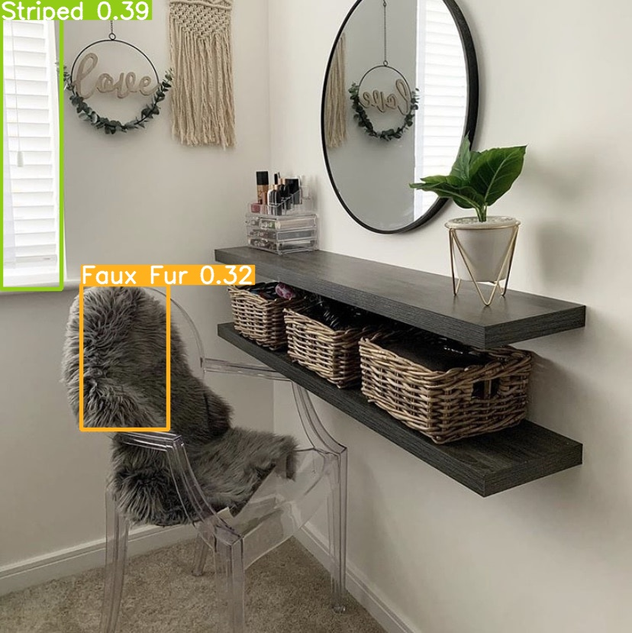
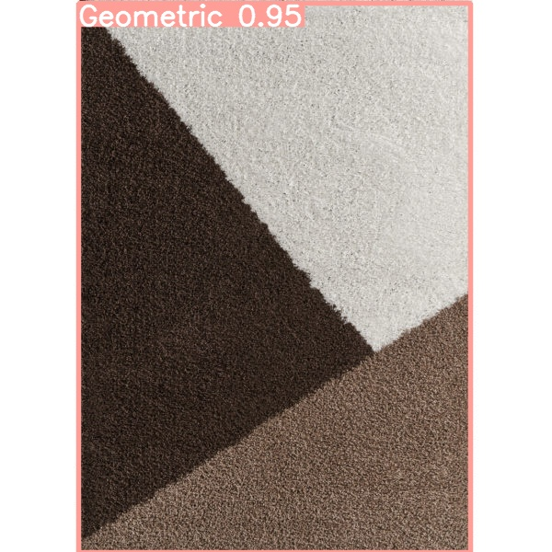
Classification of Rugs based on Styles

Slide 11
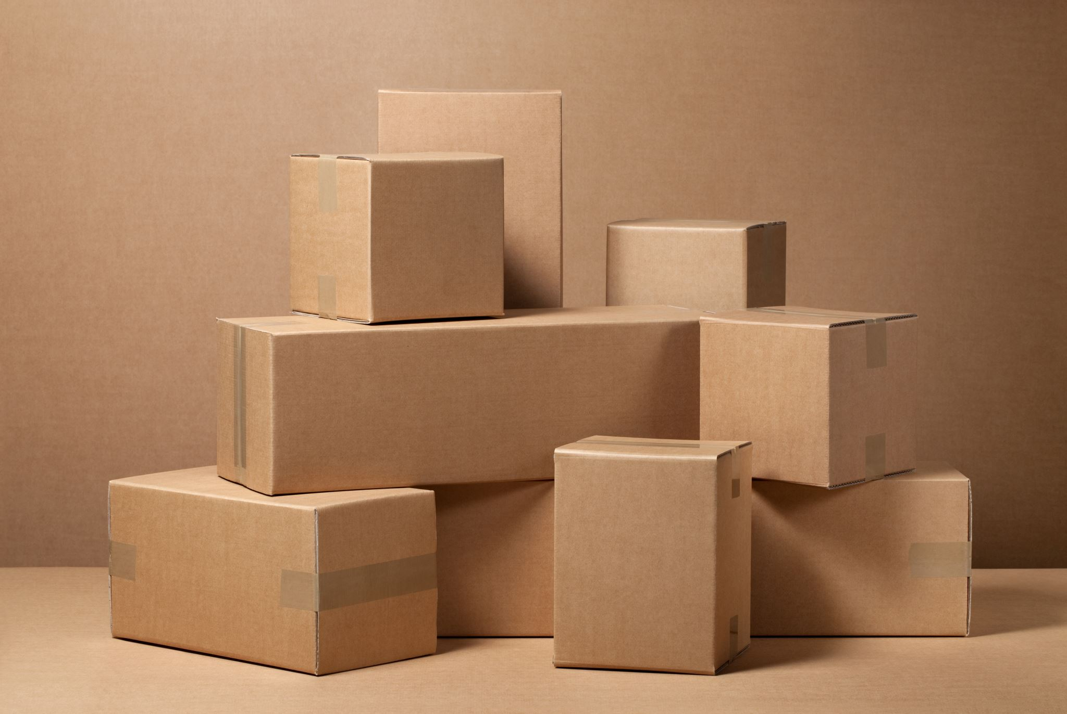
Product Analysis

Slide 12
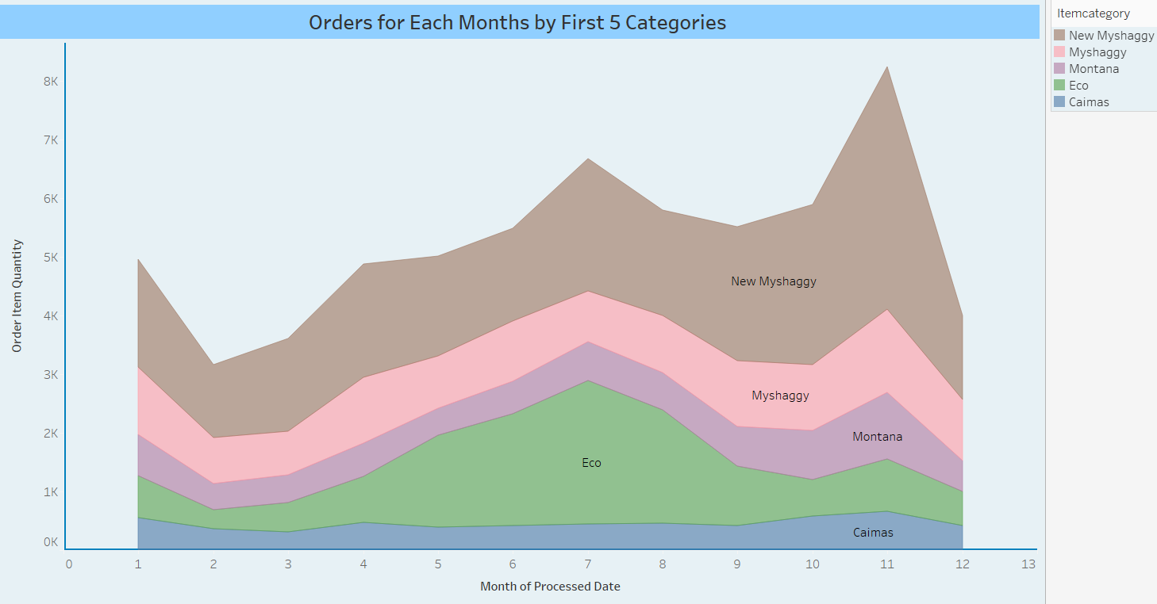
First 5 ItemCategory on Montly Basis

Slide 13
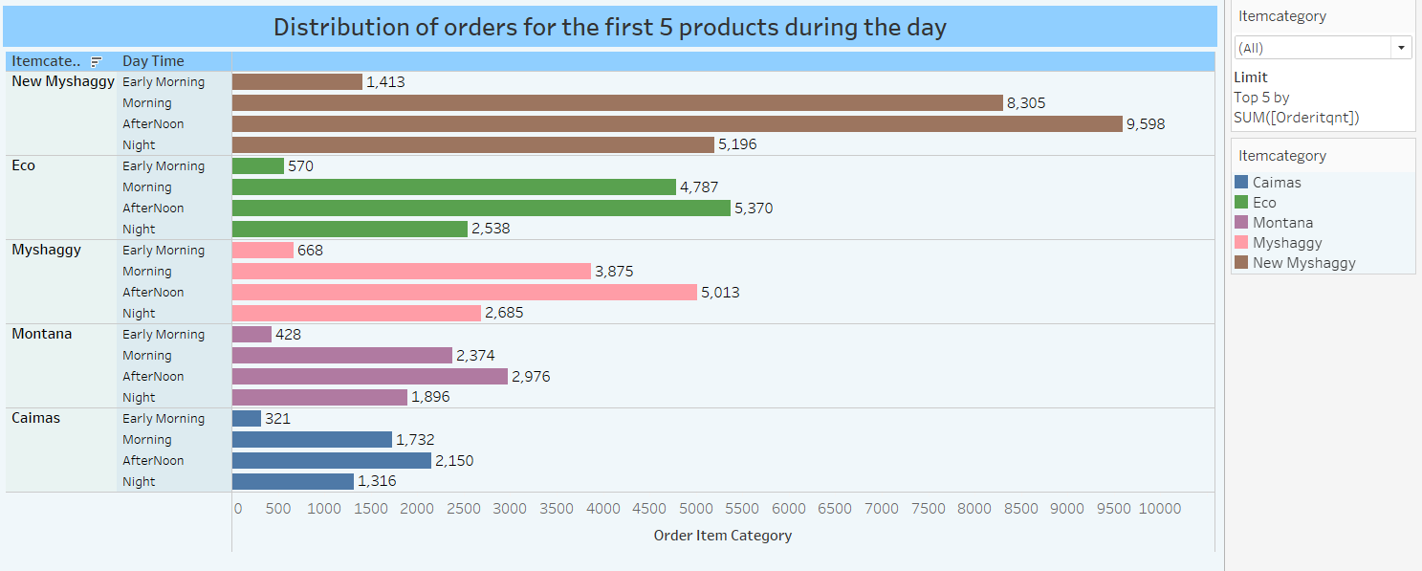
Distribution of Orders during the Day

Slide 14
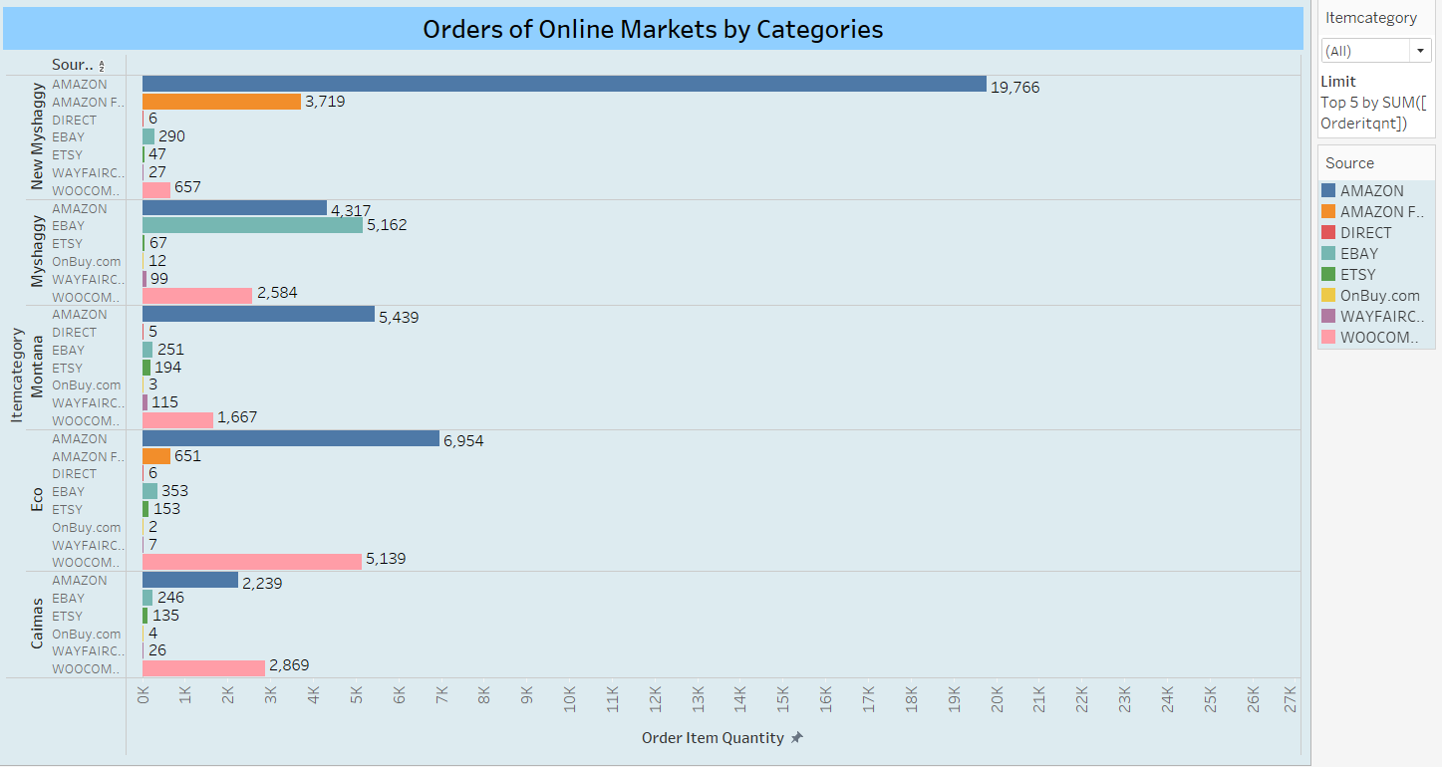
Orders by Categories

Slide 15
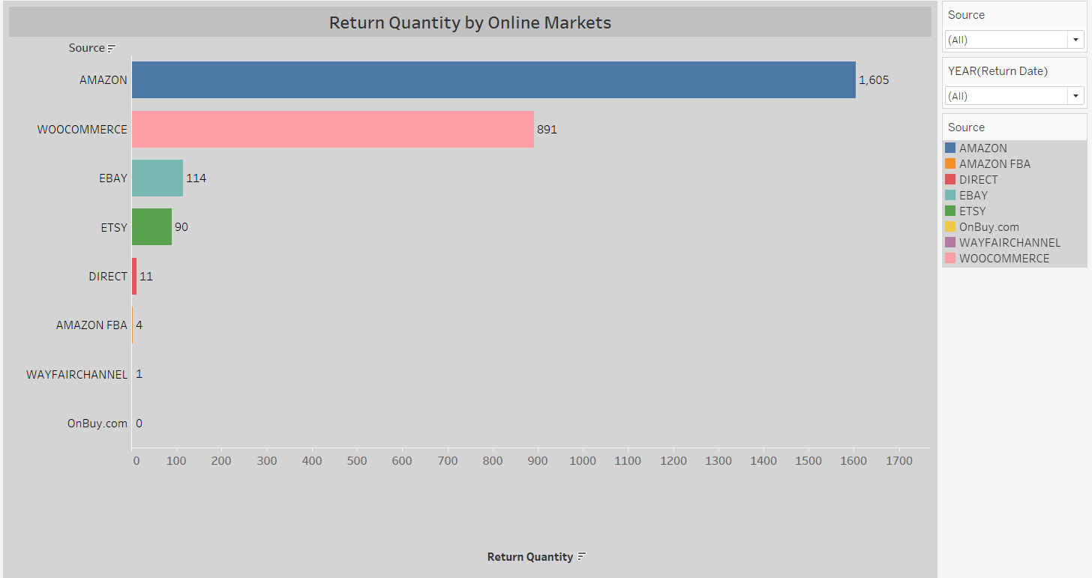
Return Quantity on Online Shops

Slide 16
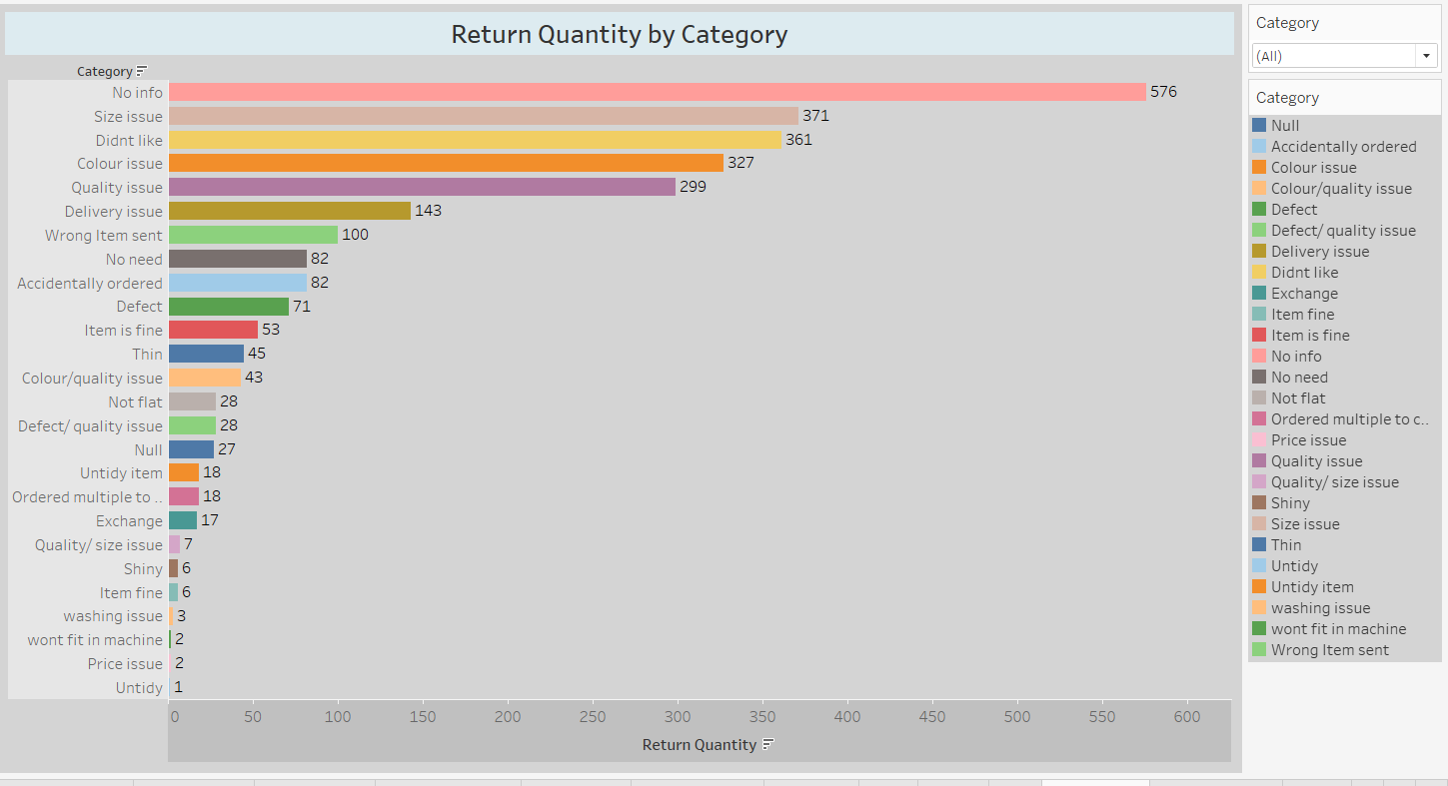
Return Reason by Category

Slide 17
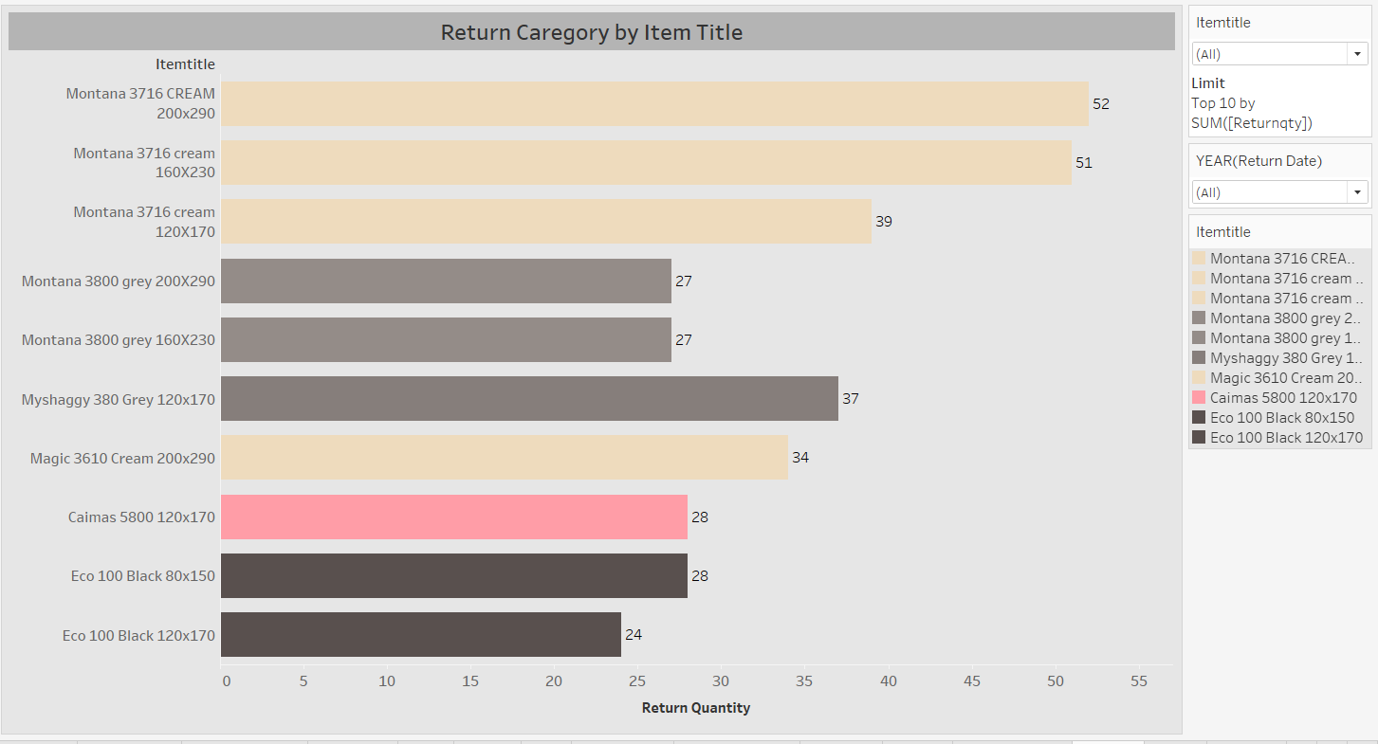
Return Category by ItemTitle

Slide 18
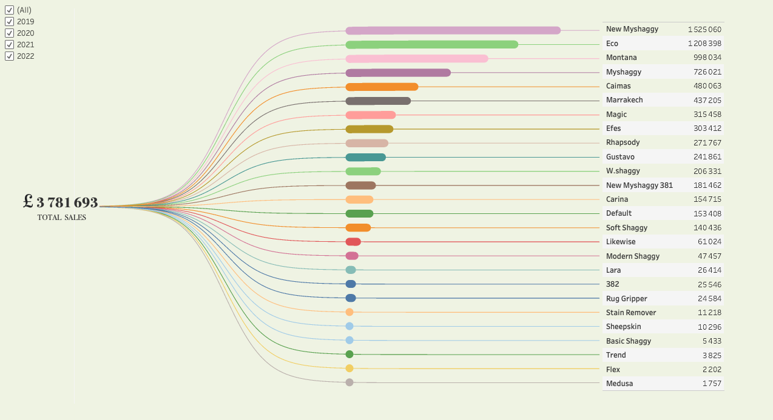
Most Popular Models and Revenue

Slide 19

Market Basket Analysis

Slide 20
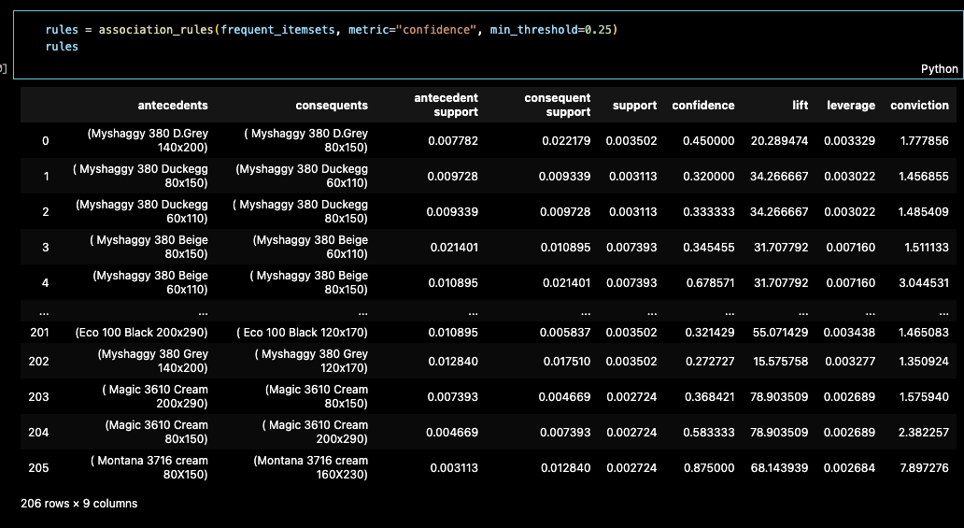
Apriori Model

Slide 21

Apriori Results
We read the table as:
Probability of getting (Myshaggy 380 D.Grey 140x200) product : 0,007782 [antecident support]
Probability of getting (Myshaggy 380 D.Grey 80x150) product: 0,022179 [consequent support]
Probability of getting both: 0,003502 [support]
The probability that the second will be added to the basket when the 1st is bought: 0,45 [confidence]

